Slide 1
Startup Hub
CHINMAYI C. RAMAKRISHNA (181IT113)
K. KEERTHANA (181IT221)

Slide 2
Agenda
Introduction
Issues and Challenges
Motivation
Problem Statement
Objectives
Proposed Work
Conclusion
Results and Analysis
Timeline of Project
Individual Contribution
References

Slide 3
Introduction
Any startup requires a huge investment. Without the right amount of funds, the entrepreneurs cannot succeed in building a company out of their innovative idea.
Finding a suitable investor can be a cumbersome, time-consuming task, and can de-motivate the entrepreneurs.
To tackle this problem, we show up list of user details willing to hold a share in the startup.
The users can view a list of startups for investing.
We are trying to implement a small scale example through our project.

Slide 4
Issues and Challenges
It was a challenge to connect high end css so that it can connect to the backend.
Our project was initially coded in html and then handlebars was used to template the same.
Understanding and using express router in the project was a challenge.

Slide 5
Motivation
A startup faces a lot of problem among which investment is the main concern.
With the right amount of investment, the startup can move a step ahead in building their company.
Novel ideas can be motivated and not lost due to the limitation of expenditure.
Startups usually spend a lot of time on finding people who might be interested and legible to their needs.

Slide 6
Problem Statement
We propose to build an interactive web site that connects startups to people. This platform displays people interested in buying shares to startups and people can choose from a list of startups.

Slide 7
Objectives
Providing sign up for two different types of users:
Start-up owners
Share buyers
Showing desirable databases to the corresponding two types of users.
Update profile details.
Provide additional features such as saving sign in information, assisting the users by providing help button and prompting alert messages on wrong entries.

Slide 8
Proposed Model
Home Page
Logged in User
Yes
Log In
No
Startup
Show share buyers list
Yes
Sign Up
No
Show start ups list

Slide 9
Methodology
We have used handlebars to template the frontend and express as a framework for the frontend.
For the database, MongoDB has been used.
A homepage is opened which gives an option to login/ sign up according to the type of user.
By selecting the type of user, data is stored in two databases to separate the details of the two.
After logging in, one type of user can view the details of other user.

Slide 10
Methodology
With the help of an express router, we provide functionalities of rendering, routing and also provide the handling of validation and errors.

Slide 11
Work Done
Creation of Homepage
A homepage layout has been created using css and html with a button which prompts to the signup/login page.
Creation of Signup/Login
The user is asked to login. If the user has not signed up, he/she is prompted to the signup page.
Handling errors
On leaving the name field empty, a message is shown.
Sign up is not allowed until a valid email is given.

Slide 12
Work Done
Handling Validation
The login details are verified with the database.
If it’s a new entry, user is prompted to sign up page.
Creating database using MongoDB
Two databases have been created for the two types of users namely share buyers and startups.

Slide 13
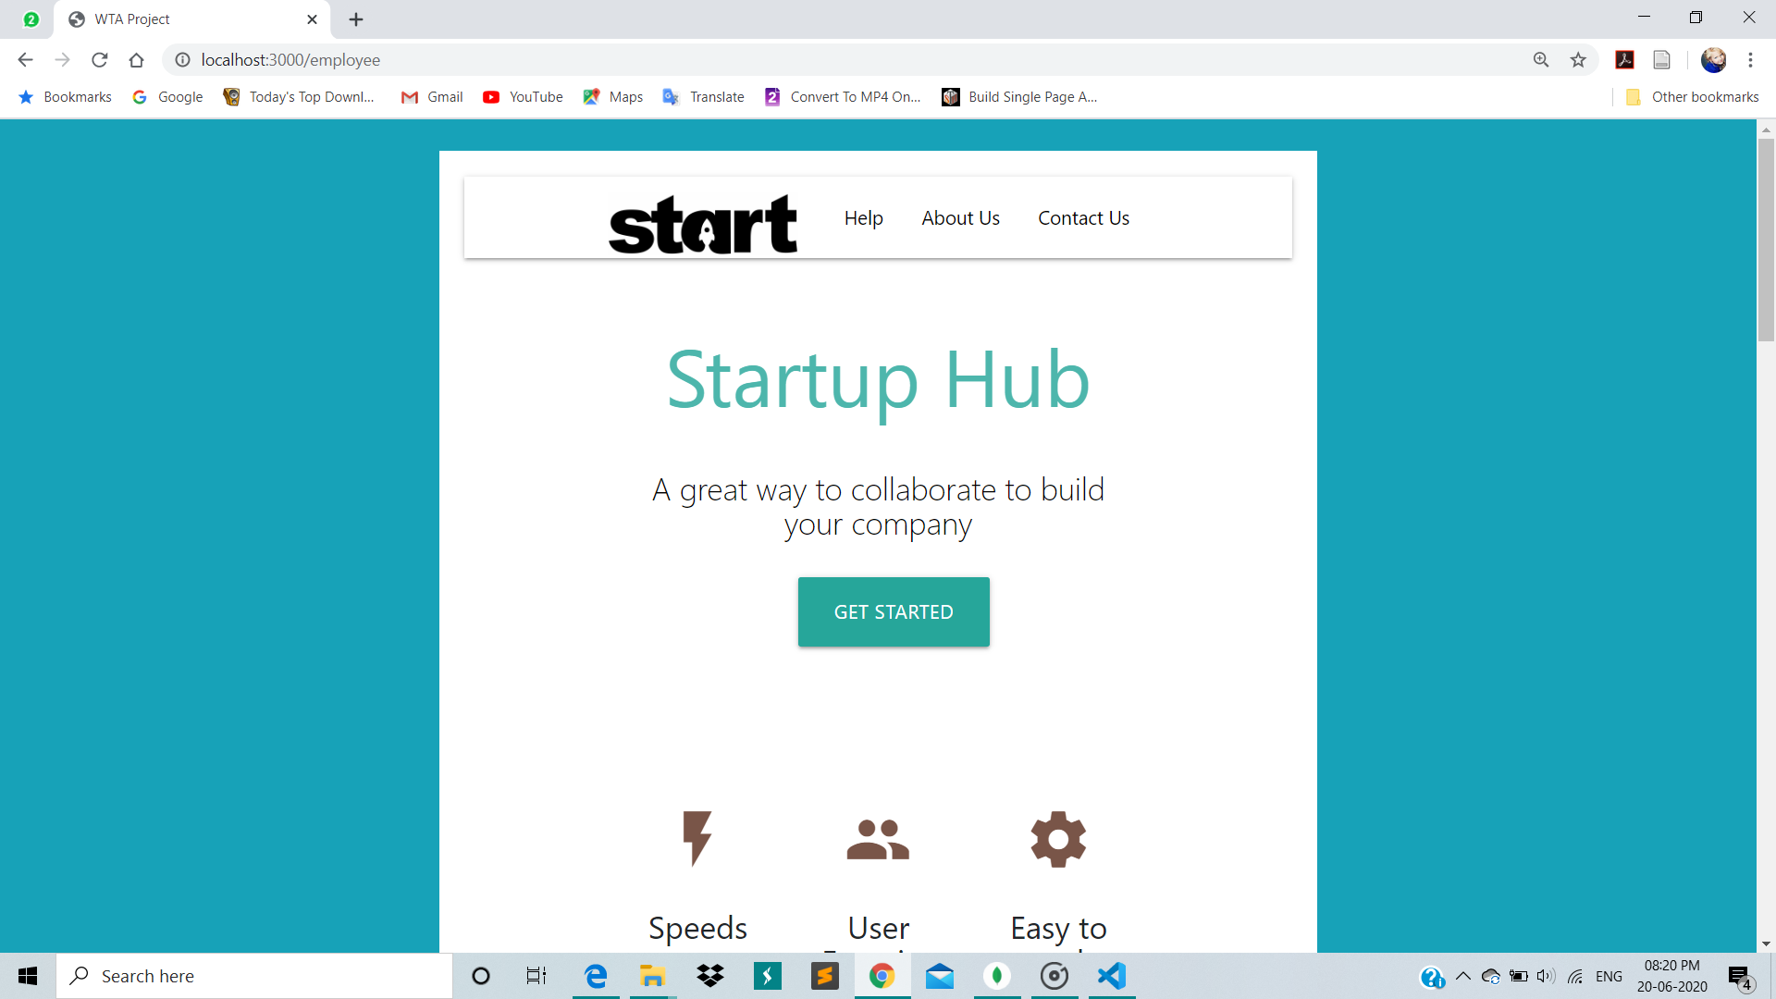
Results and Analysis
Fig 1. Home Page

Slide 14
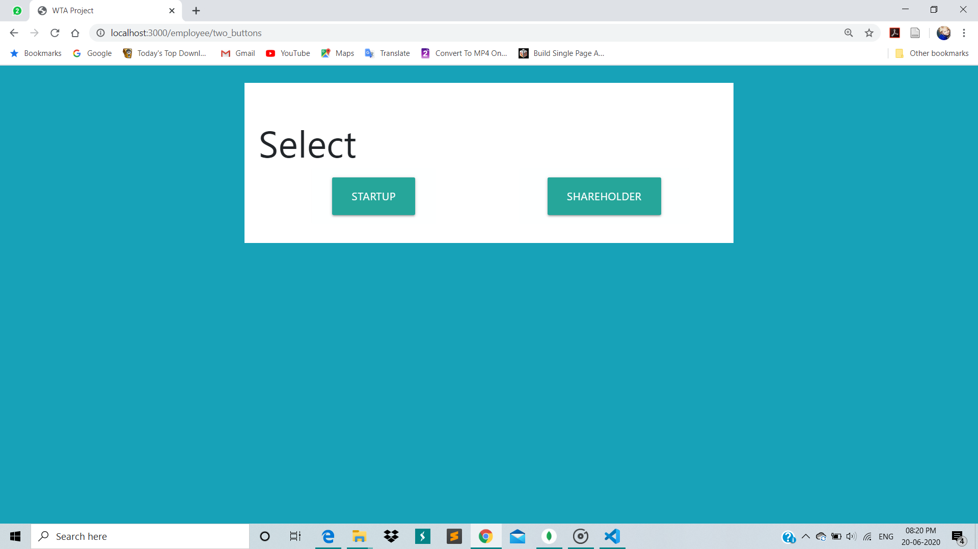
Results and Analysis
Fig 2. Select type of user

Slide 15
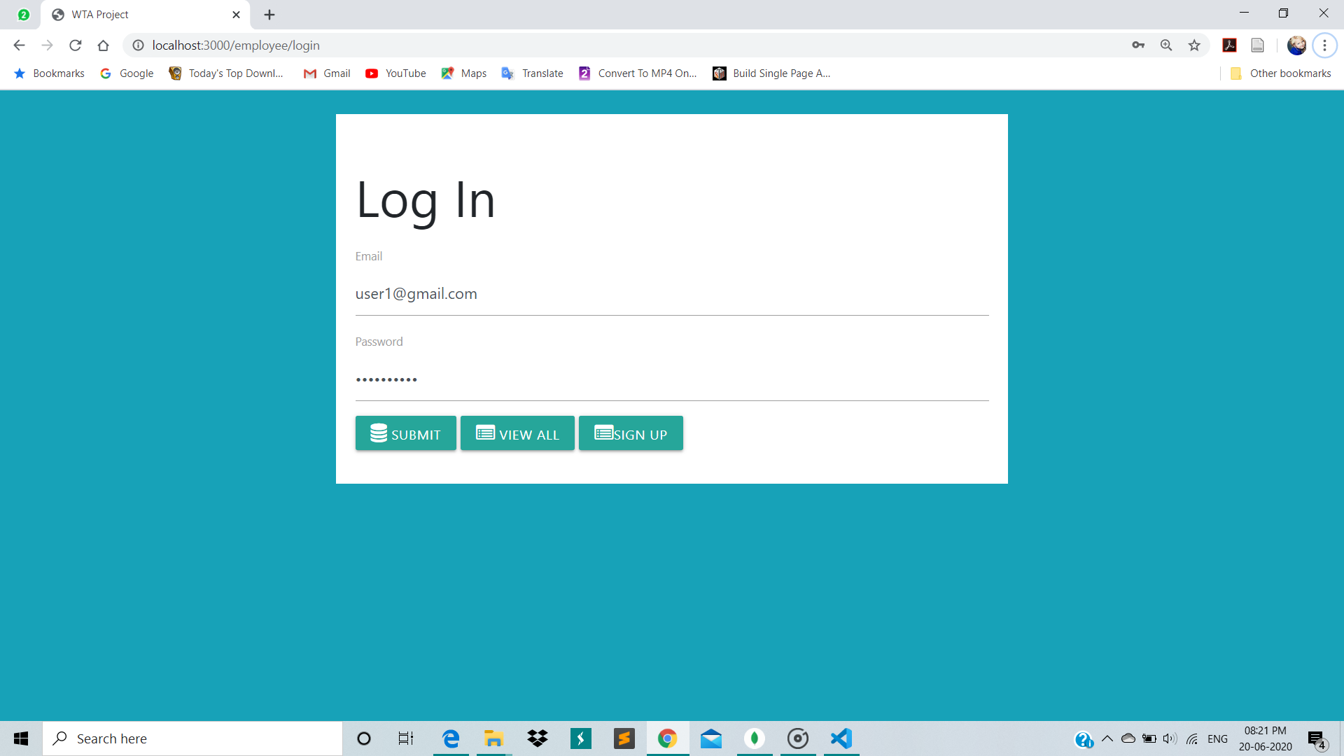
Results and Analysis
Fig 3. Log In for Shareholder

Slide 16
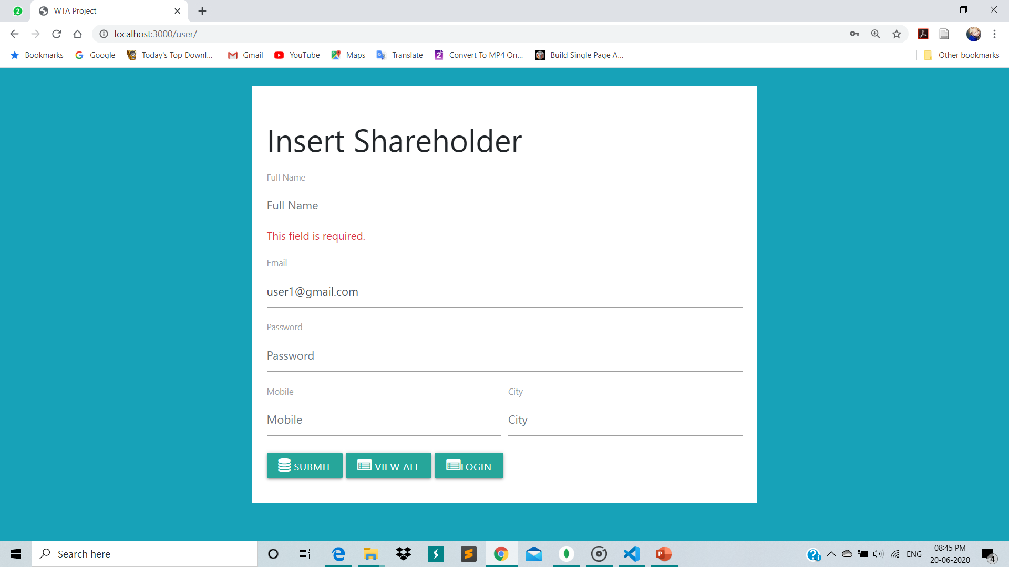
Results and Analysis
Fig 4. Sign Up for Shareholder

Slide 17
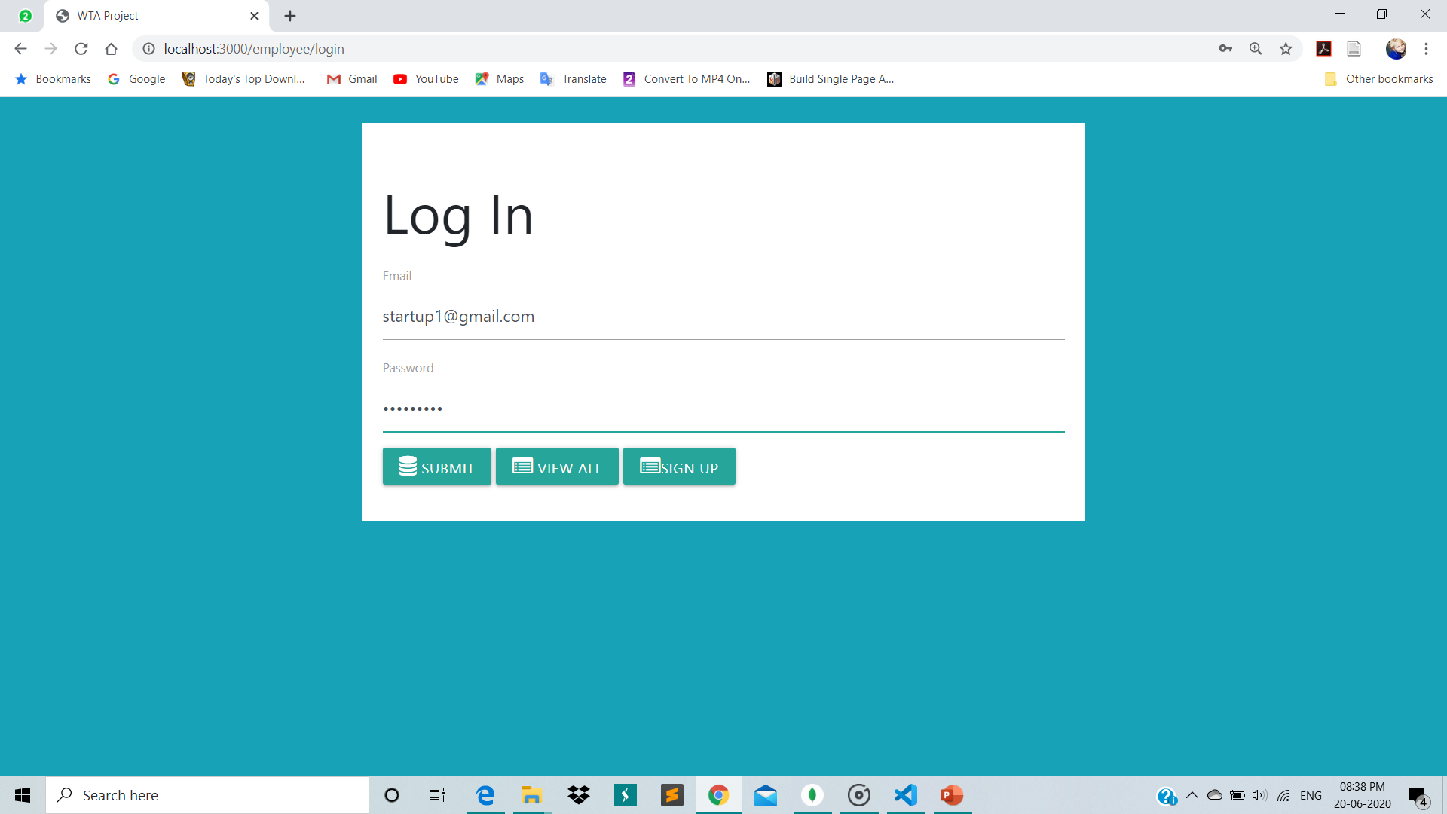
Results and Analysis
Fig 5. Log In for Start Up

Slide 18
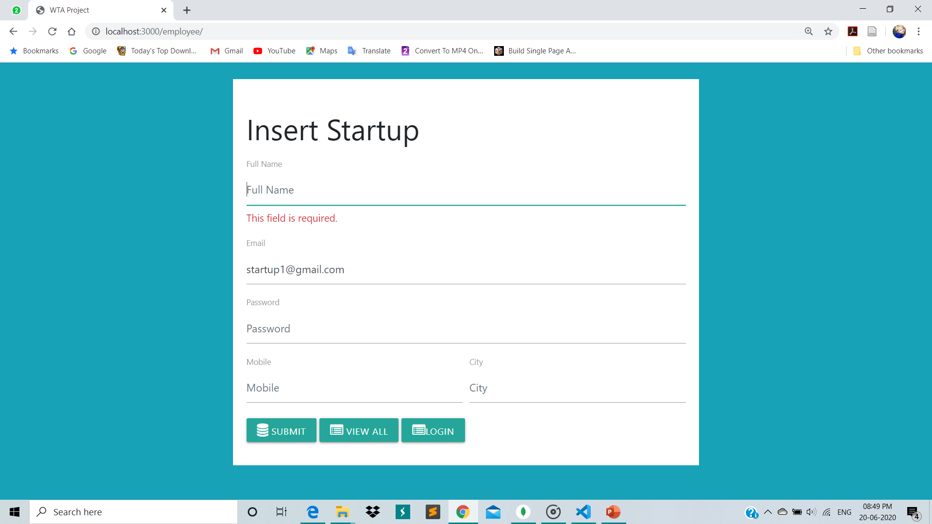
Results and Analysis
Fig 6. Sign Up for Startup

Slide 19
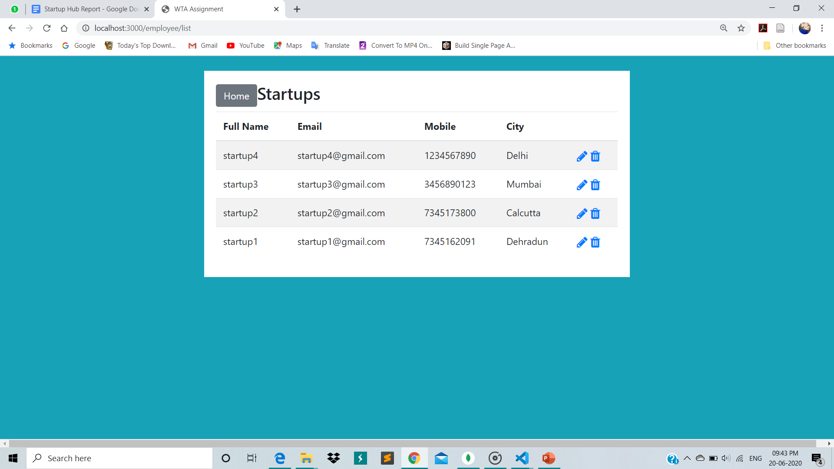
Results and Analysis
Fig 7. List of startups

Slide 20
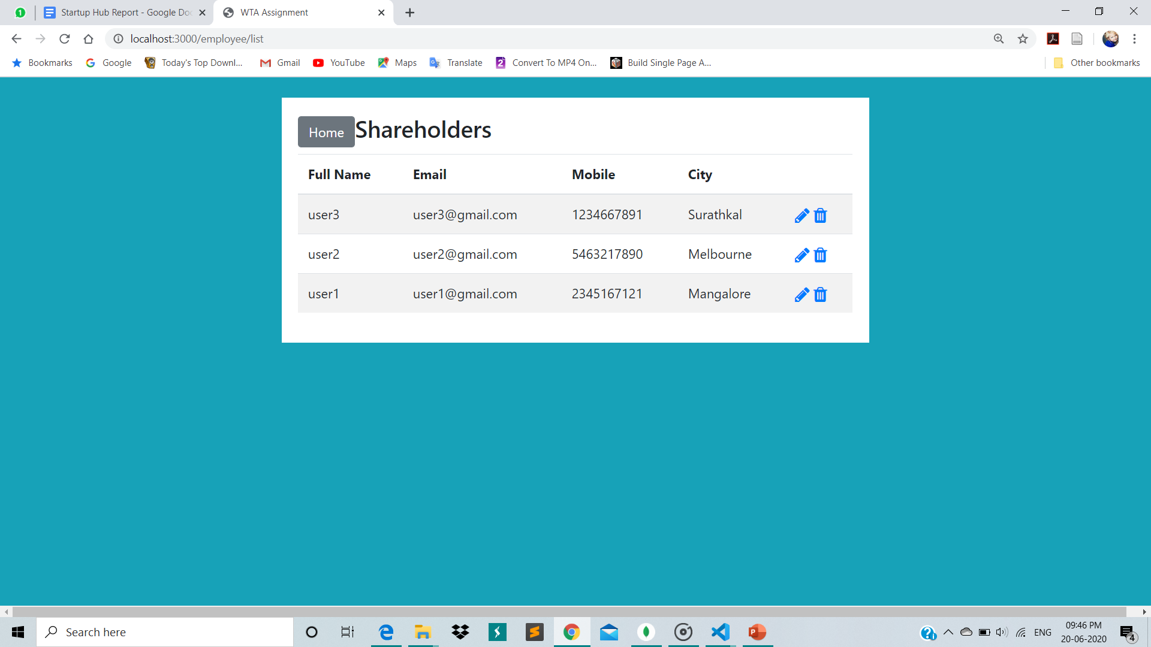
Results and Analysis
Fig 8. List of Shareholders

Slide 21
Time Line of Project
Milestones | Jan 2018 | Feb 2018 | Mar 2018 | April 2018
Basic template of the webpage | 1
Login /Sign Up |  | 2
Adding express routing and rendering |  |  | 3
Adding databases |  |  |  | 4
Connecting the framework and MongoDB |  |  |  | 4

Slide 22
Individual Contribution
Chinmayi C. Ramakrishna | K. Keerthana
Login Page, Home Page | Sign up Page, Database page
Database for the start up | Database for the user
Connecting frontend and backend | Displaying desired databases to the users.

Slide 23
References
[1] https://www.w3schools.com/default.asp
[2] https://nccur.lib.nccu.edu.tw/bitstream/140.119/33947/6/93306406.pdf
[3] https://codeforgeek.com/expressjs-router-tutorial/
[4] https://angel.co/india

